Slide 1
Decoding GST System Generated Notices DRC-01B
CA ROHIT PRASAD
SEMINAR AT EIRC – ICAI
Date : 24th April 2024

Slide 2
Benefits of System Generated Notices for Taxpayers:
Interest : Early identification of errors between GSTR-1 and GSTR-3B, helps in immediate corrections and reduces interest costs.
Better GST Compliance : Taxpayers will be mindful while filing GSTR-1 & GSTR-3B now. This will automatically instigate a reconciliation process to be in-built into GST Returns Compliance.
Annual Returns : While the above returns are filed after reconciling with Books of accounts on a month basis, the filing of GSTR-9 and GSTR-9C becomes easier and more accurate, improving overall tax compliance.
No Manual Intervention : The Notices are generally automatically which doesn’t require manual intervention.

Slide 3
Key Highlights of Form DRC-01B
On 26th December 2022, The Government of India inserted a new Rule 88C to the Central Goods and Services Tax (CGST) Rules, 2017.
The Form DRC-01B is a System Generated Notice and the notice was issued was for the month of October 2023.
This rule allows automated notifications to be sent to taxpayers if there is any mismatch between their output tax liability in GSTR-1/IFF and GSTR-3B. Generally GSTR-1 Liability is more than GSTR-3B then DRC-01B is issued.
The Form DRC-01B is applicable for regular taxpayers including SEZ units, SEZ developers, Casual taxpayers and Composition scheme taxpayers.
The intimation of DRC-01B is intimated through E-mail and SMS.
The Form DRC-01B has two parts- Part A(Intimation to Taxpayer) and Part B(Reply for the Intimation issued in DRC-01B Part A).
The time limit to file DRC-01B is within 7 Days from the date of intimation. If not filed timely, then the taxpayer cannot file GSTR 1/IFF for the subsequent period.

Slide 4
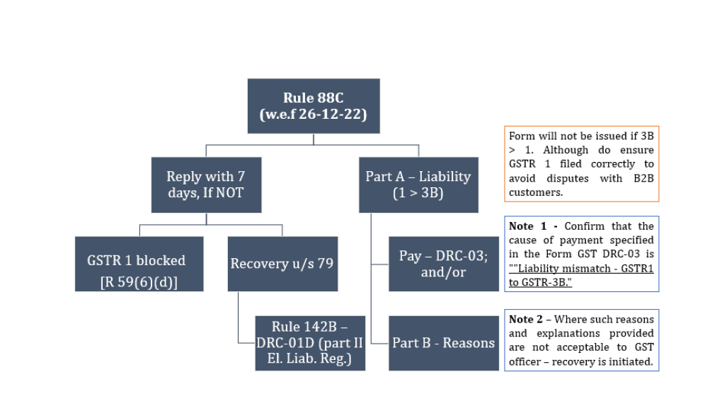
Rule 88C of CGST Rules, 2017

Slide 5
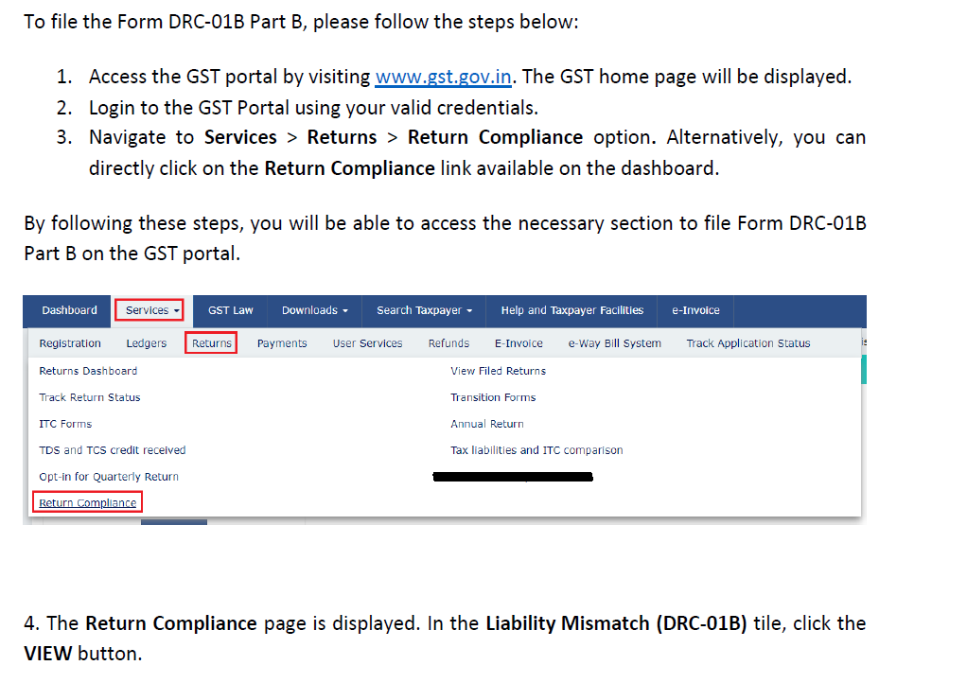
How Can I File Form DRC-01B PART B?

Slide 6
Click on View – DRC-01B

Slide 7
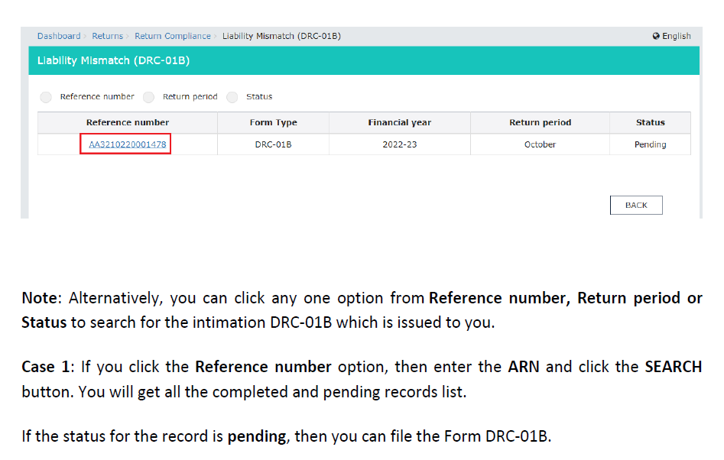
Search Options for DRC-01B :

Slide 8
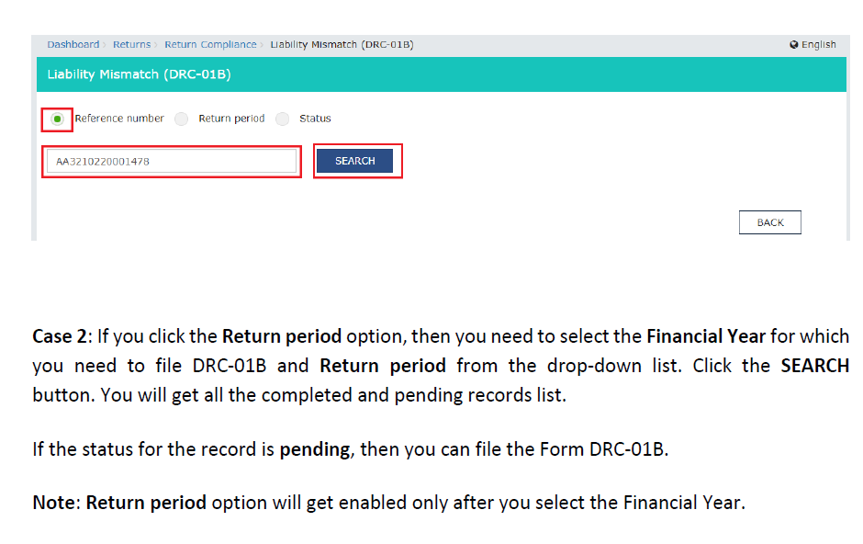
Search Options using Reference Number

Slide 9
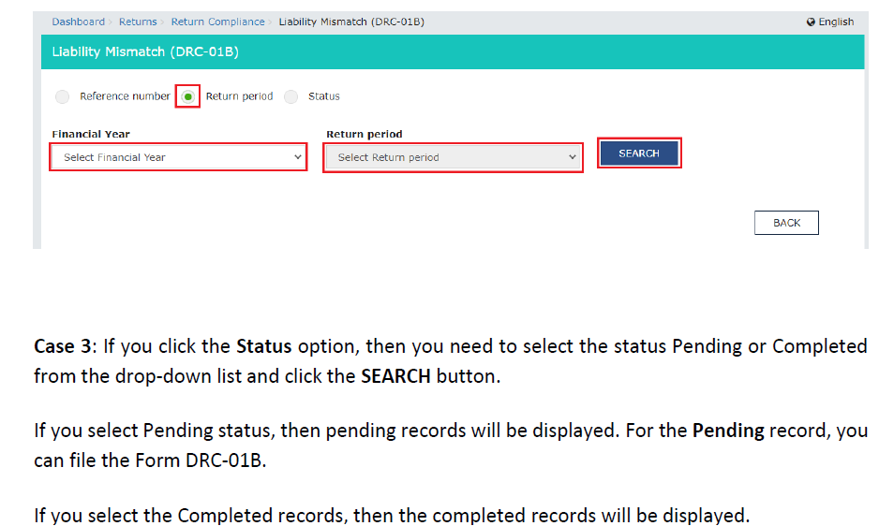
Search Options using Return Period

Slide 10
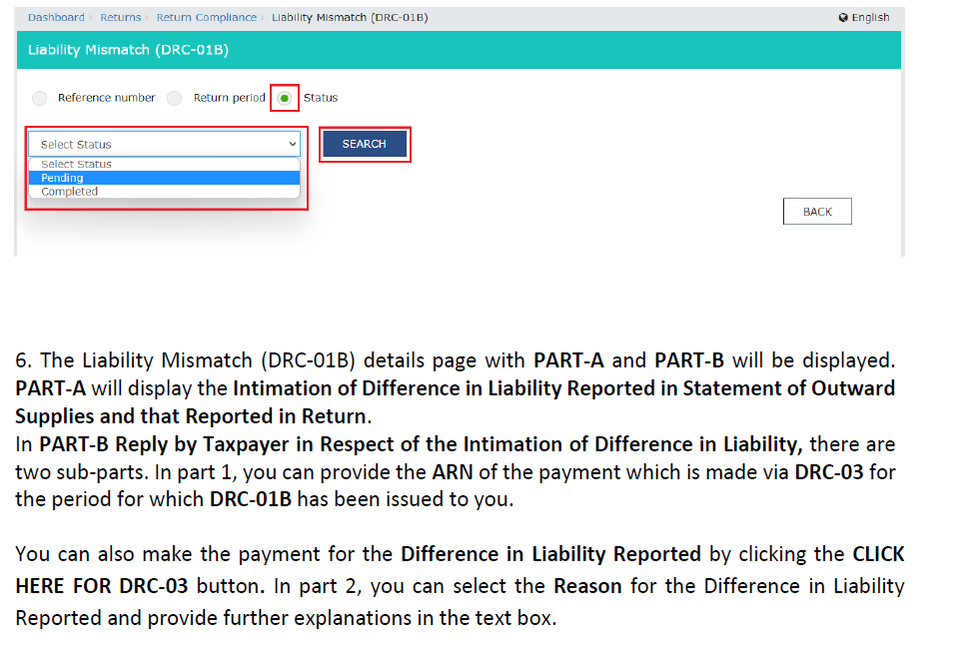
Search Options using Status

Slide 11
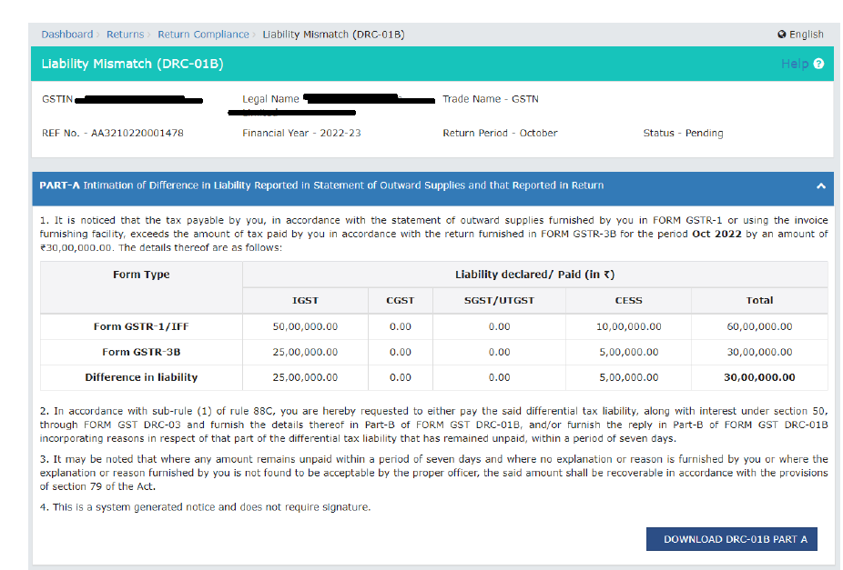
Intimation to Taxpayer -DRC-01B – Part A

Slide 12
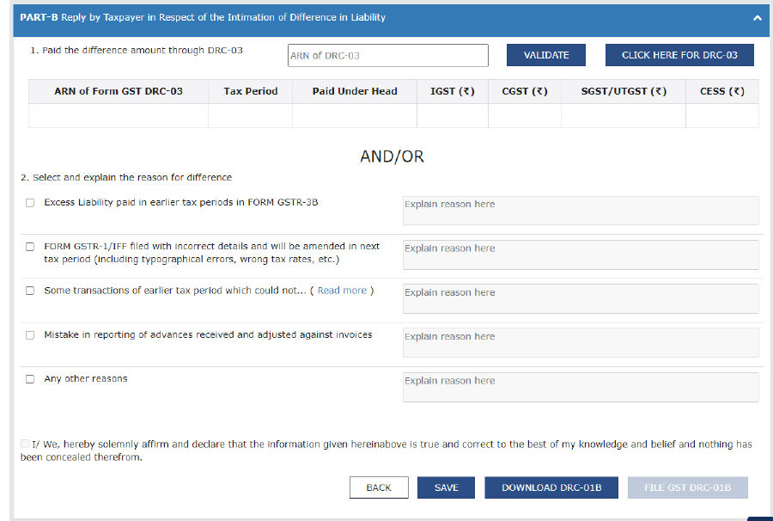
DRC-01B – Part B – Reply by Taxpayer in respect of the Intimation of Difference in Liability

Slide 13
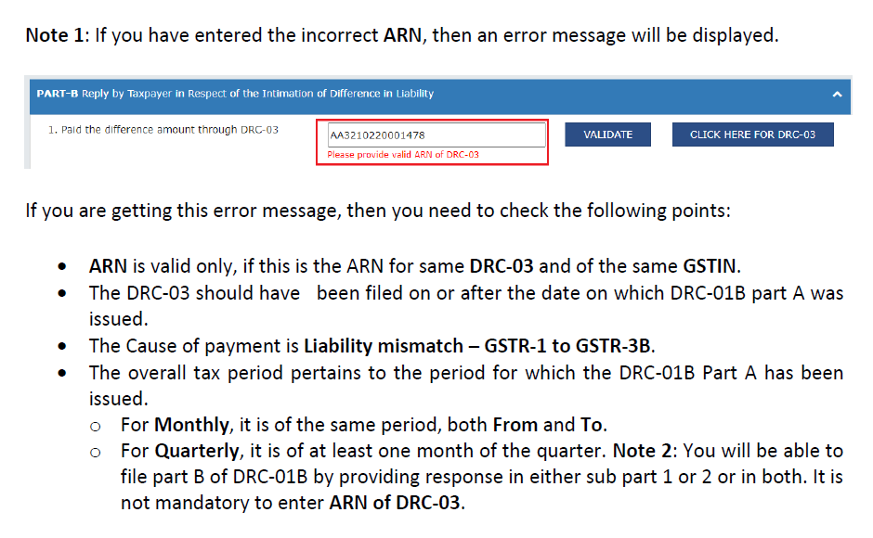
Correct Application Reference Number (ARN)

Slide 14
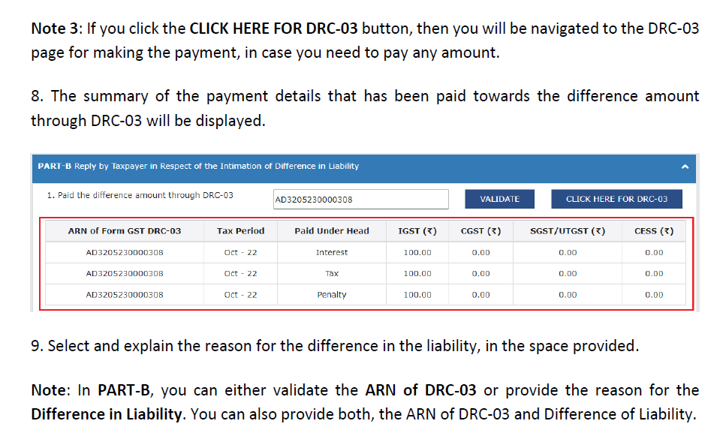
Select the Appropriate Payment Amount

Slide 15
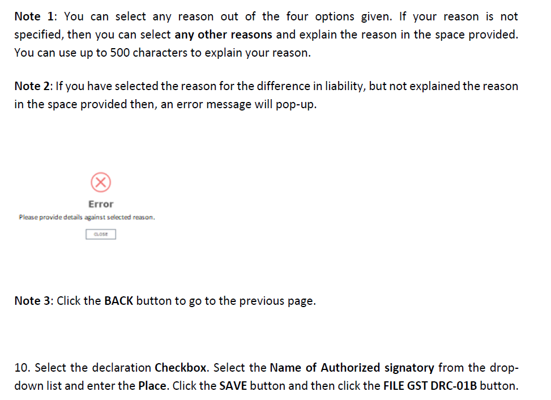
How to Avoid Error at the time of filing of DRC-01B

Slide 16
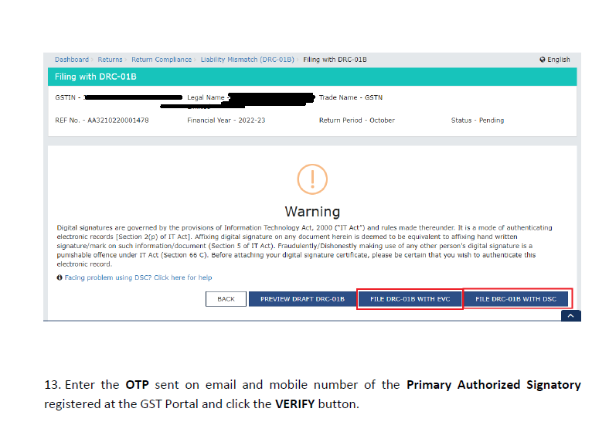
Final Filing of DRC-01B – EVC or DSC

Slide 17
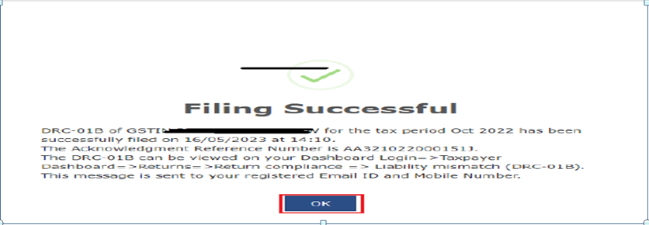
DRC-01B Successfully Filed

Slide 18
Reasons for Mismatch of Output Tax Liability in GSTR-1 V/S GSTR-3B
Misallocation: GSTR-1 is prepared at the invoice level and GSTR-3B is prepared at the aggregate level. This can lead to furnishing supplies under the wrong head in GSTR-3B, but declaring the same details correctly in GSTR-1.
Typographical Errors in reporting of figures in GSTR-3B and GSTR-1.
Wrong Tax Heads: The total value of supplies is correctly shown but taxes are paid under the wrong head.
Excess Liability has been paid through GSTR-3B but later been correctly reported in GSTR-1.

Slide 19
Selection of Appropriate Reasons at the time of Filing of FORM DRC-01B
Reason No. | Reason Heading | Key Points
Reason No. : 1 | Excess Liability paid in earlier tax periods in FORM GSTR-3B. | If you had paid excess output tax liability in previous periods through GSTR-3B as compared to GSTR-1, then select this reason. GSTR-3B Filed Wrongly in Previous Period then select this reason. ( Explain the Reasons within 500 characters).
Reason No. : 2 | FORM GSTR-1/IFF filed with incorrect details and will be amended in next tax period (including typographical errors, wrong tax rates, etc.) | If GSTR-1/IFF has been filed wrongly in the previous tax periods then select this reason. Typographical Errors in GSTR-1 Selection of Wrong Tax Rates in GSTR-1
Reason No. : 3 | Some transactions of earlier tax period which could not be declared in the FORM GSTR-1/IFF of the said tax period but in respect of which tax has already been paid in FORM GSTR-3B of the said tax period and which have now been declared in FORM GSTR-1/IFF of the tax period under consideration. | Transaction not declared in earlier GSTR-1 but tax has been declared and Paid in GSTR-3B of earlier tax period and in the current period of GSTR-1 the output tax liability has been declared.
Reason No. : 4 | Mistake in reporting of advances received and adjusted against invoices | Any mistake in the reporting of Advances received (services) , then select this reason.
Reason No. : 5 | Any other reasons. | If the reason for the output tax liability is other than the above four reasons then select this reason. If Payment made through DRC-03 then select this reason.

Slide 20
What if DRC-01B is not Filed ? Consequences
In the case where the amount specified in
DRC-01B remains unpaid, or
No reply was furnished, or
where the reply furnished was found to be unacceptable by the proper officer.
then proper officer shall intimate, electronically on the common portal, the details of the said amount in FORM GST DRC-01D, directing the person in default to pay the said amount, along with applicable interest, or, as the case may the amount of interest, within seven days of the date of the said intimation.
Interest is to be charged u/s 50 of the CGST Act, 2017, for the unpaid output tax liability amount.
i.e., (Interest @18% p.a.)

Slide 21
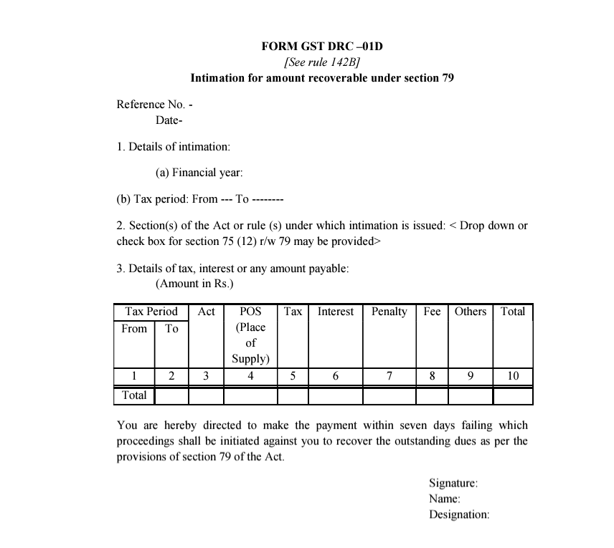
DRC-01D – Intimation for amount recoverable u/s 79 of CGST Act,2017

Slide 22
Highlights of section 79 of CGST Act, 2017
Deduction from Owing Funds : The proper officer can deduct or instruct another officer to deduct the payable amount from any money owed to the defaulter by the government.
Detention and Sale of Goods: The officer has the authority to recover the amount by detaining and selling goods owned by the defaulter that are under the officer's control.
Recovery from Third Parties: The officer can issue a notice to any person owing money to the defaulter, requiring them to pay the government directly.
Distraint of Property : The officer, following rules, can distraint movable or immovable property under the defaulter's control and detain it until the amount is paid. If unpaid for a specified period, the property may be sold to satisfy the outstanding amount.
Legal Proceedings : The officer may file an application to the Magistrate for recovery, treating the amount as if it were a fine imposed by the Magistrate.

Slide 23
For any clarification
Contact : +91-8697266146
Email : carohitprasad@gmail.com

